Slide 1
An ROI-based LiDAR sampling algorithm in the road environment
Nguyen Khac Thai
2018.07.06

Slide 2
Content
Introduction
Previous approaches
Proposed algorithm
Experiment results
Conclusion

Slide 3
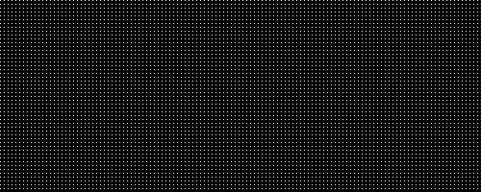
Introduction
LiDAR sampling rate is low
Lead to the problem of sampling to increase the efficiency
Our lab’s lidar system [1]
Be able to measure any desired locations in any order
Sampling rate is limited to 100,000 measurements per second
The sampling problem
Find a sampling map specifies which points should be sampled
Uniform or grid sampling; the most common sampling strategy
[1] Xuan Truong Nguyen, Dinh Van Luan, Hyun Kim, and Hyuk-Jae Lee, "A High-Definition LIDAR System Based on Two-Mirror Deflection Scanners," IEEE Sensors Journal, Volume: 18, Issue: 2, Pages : 559-568, Jan. 2018.

Slide 4
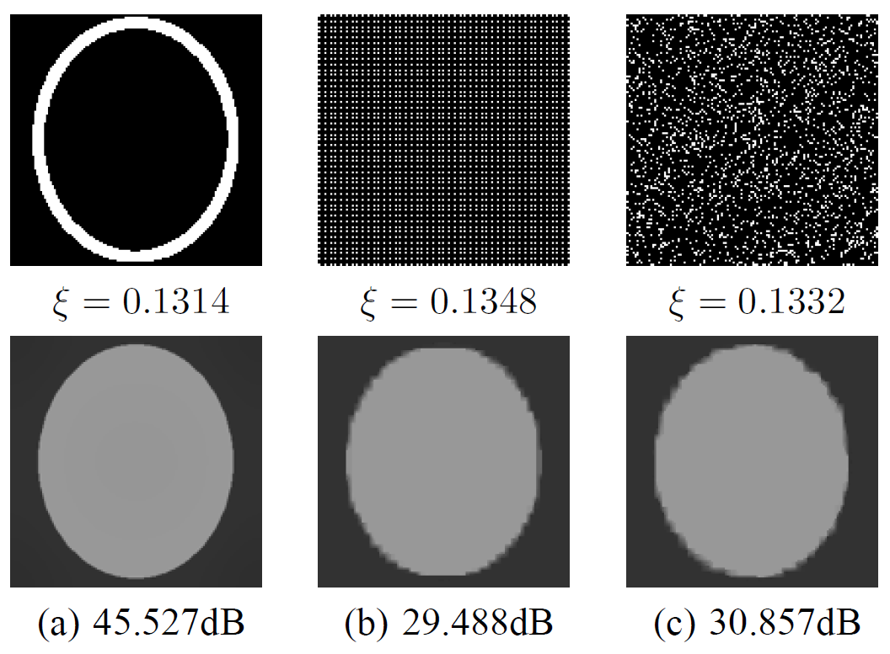
Previous approaches
Depth-gradient-based sampling [2]
Propose that sampling along the depth gradient gives the optimal result
Successfully recover the depth map in Middlebury dataset with 5% of samples
Inspired for compress sensing
In real systems, depth gradient is not available before sampling
Two-step sampling [3]
Apply depth-gradient-based sampling in a practical manner
Step 1: Sample uniformly with half budget and reconstruct to find the gradient of reconstructed map
Step 2: Sampling along the gradient map
Not effective for complex scenes with a significant amount of outliers
Gradient-based sampling (a) compared to grid sampling (b) and random sampling (c)
[2] S. Hawe, M. Kleinsteuber, and K. Diepold, “Dense disparity maps from sparse disparity measurements,” in Proc. IEEE Int. Conf. Computer Vision (ICCV’11), Nov. 2011, pp. 2126–2133.
[3] L.-K Liu, S.H. Chan, and T.Q. Nguyen, “Depth reconstruction from sparse samples: Representation, algorithm, and sampling,” IEEE Trans. on Image Process., vol. 24, no. 6, pp. 1983–1996, Jun. 2015.

Slide 5
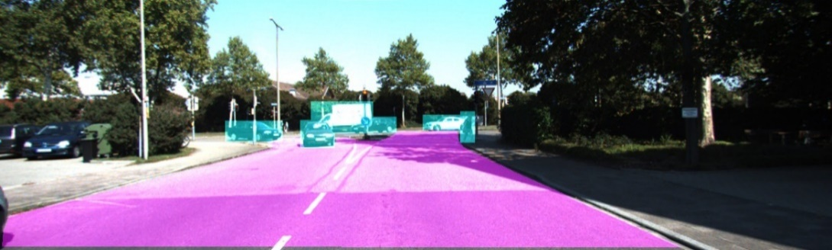
Proposed approach
Our application of LiDAR sampling with ADAS
Objective
Gather more information in ROI area, especially the objects area
The design covers the case of a very low sampling rate (roughly 1%)
Region of Interest (ROI) includes
The road
The objects
Cars that are on the road
Cyclists and pedestrians
Road
Cars, cyclists, pedestrians
A typical road scene in KITTI dataset

Slide 6
Proposed approach
Workflow
Capturing an image by the camera
Image segmentation to 3 areas: road, objects, and background
Sampling process (the focus of this work)
Proposed approach
Move a portion of samples outside ROI into ROI area
In existing systems, the sampling rate is equal in entire Field of View
Inside ROI, move samples from the road to objects area
In existing systems, road area has 6.75 times more samples than objects area
Segmentation
Sampling
Road detection
ROI
Image
Road
Objects
Object detection
Background

Slide 7

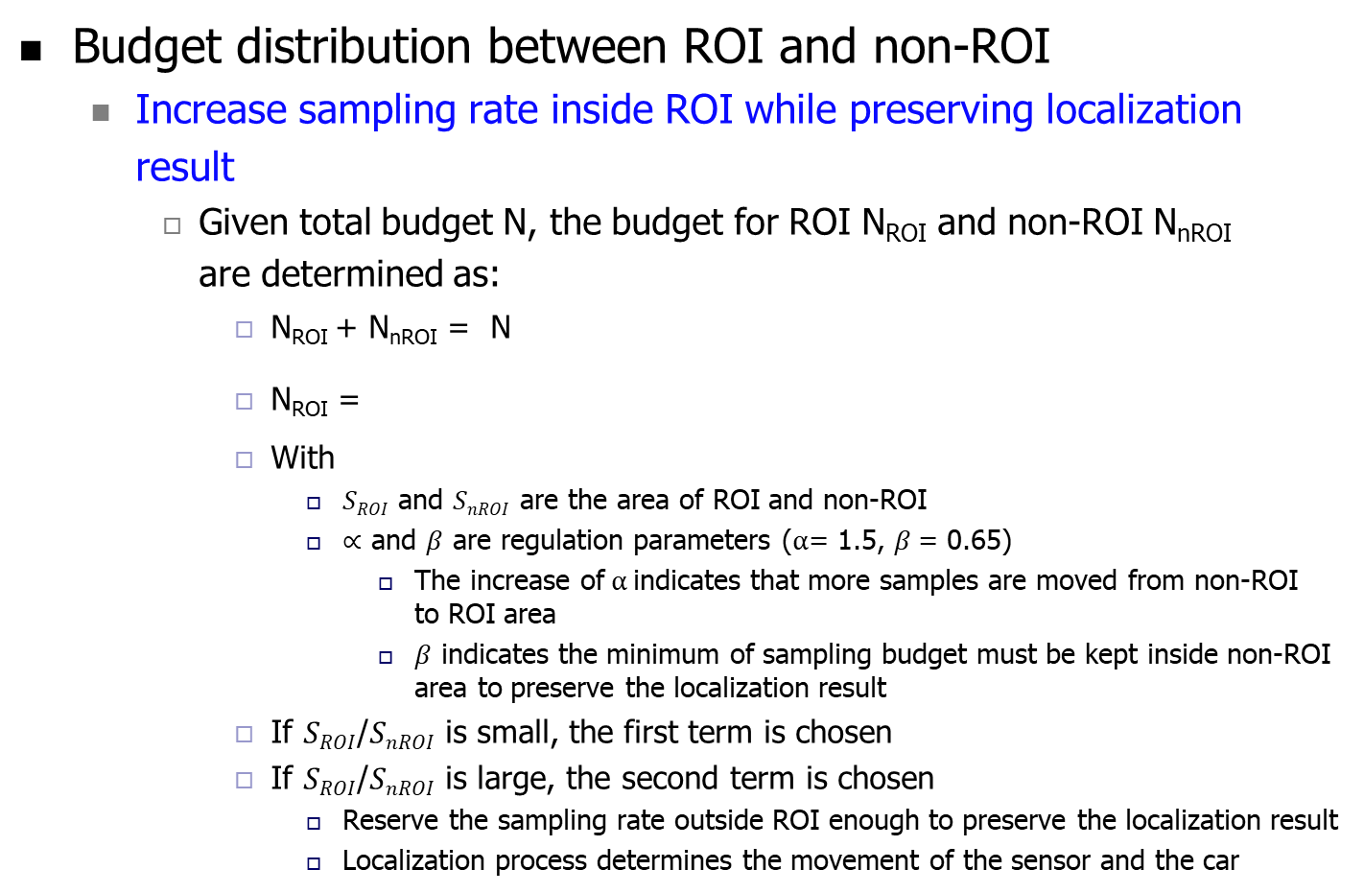
Proposed approach
Budget distribution between ROI and non-ROI
Increase sampling rate inside ROI while preserving localization result
Given total budget N, the budget for ROI N_{ROI} and non-ROI N_{nROI} are determined as:
N_{ROI} + N_{nROI} = N
N_{ROI} =
With
$SROI$ and $SnROI$ are the area of ROI and non-ROI
$∝$ and $β$ are regulation parameters ($α$= 1.5, $β$= 0.65)
The increase of$α$indicates that more samples are moved from non-ROI to ROI area
$β$ indicates the minimum of sampling budget must be kept inside non-ROI area to preserve the localization result
If $SROI$/$SnROI$ is small, the first term is chosen
If $SROI$/$SnROI$ is large, the second term is chosen
Reserve the sampling rate outside ROI enough to preserve the localization result
Localization process determines the movement of the sensor and the car

Slide 8
Proposed approach
Budget distribution inside ROI
Characteristics of reconstruction quality in road and objects area
Mean Absolute Error (MAE) of the road area converges very fast, starting from 0.11%
This convergence is stable in all tested images
MAE of objects area is much worse and no convergence found
Indicate the need to increase the rate in objects area as high as possible
(a) Road area
(b) Objects’ area
Reconstruction result of the road and objects’ area in dependency of sampling rate

Slide 9
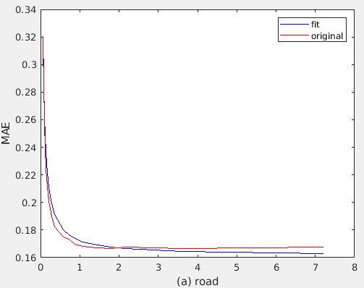
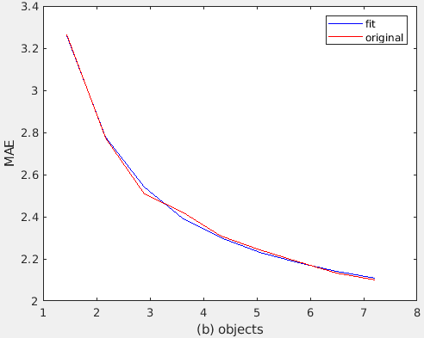
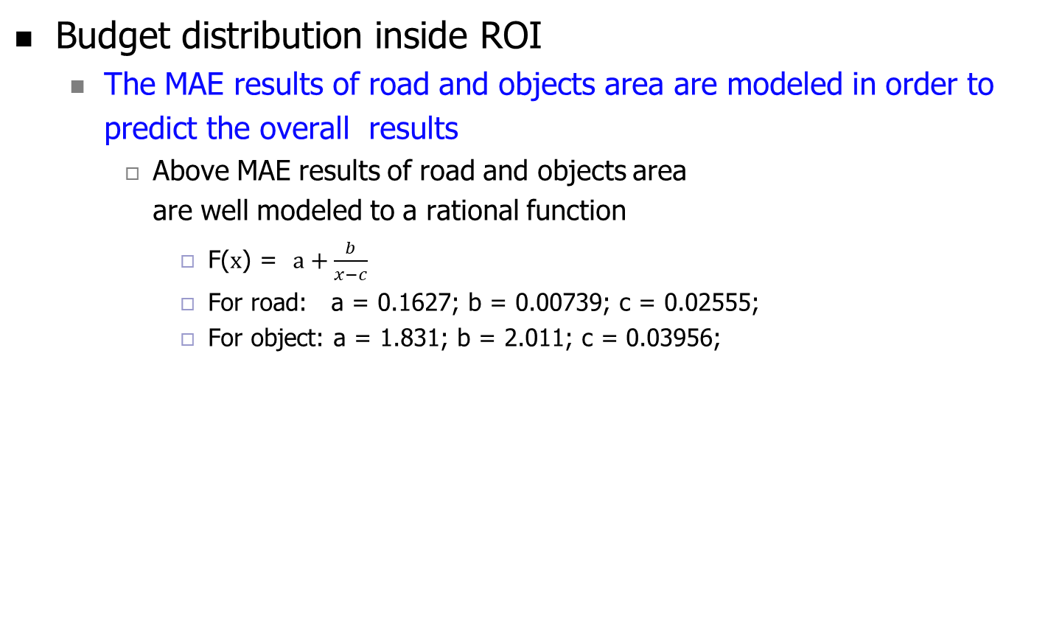
Proposed approach
Budget distribution inside ROI
The MAE results of road and objects area are modeled in order to predict the overall results
Above MAE results of road and objects area are well modeled to a rational function
F(x) = $a+\frac{b}{x−c}$
For road: a = 0.1627; b = 0.00739; c = 0.02555;
For object: a = 1.831; b = 2.011; c = 0.03956;
Original vs modeled function

Slide 10

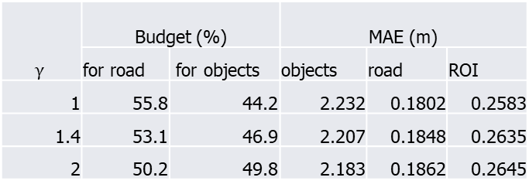
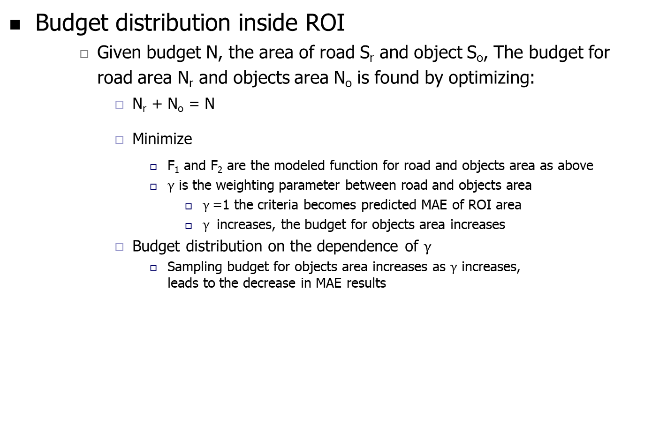
Proposed approach
Budget distribution inside ROI
Given budget N, the area of road S_{r} and object S_{o}, The budget for road area N_{r} and objects area N_{o} is found by optimizing:
N_{r} + N_{o} = N
Minimize
F₁ and F₂ are the modeled function for road and objects area as above
$γ$ is the weighting parameter between road and objects area
$γ$=1 the criteria becomes predicted MAE of ROI area
$γ$ increases, the budget for objects area increases
Budget distribution on the dependence of $γ$
Sampling budget for objects area increases as $γ$ increases, leads to the decrease in MAE results
$$γ$$ | Budget (%) |  | MAE (m)
 | for road | for objects | objects | road | ROI
1 | 55.8 | 44.2 | 2.232 | 0.1802 | 0.2583
1.4 | 53.1 | 46.9 | 2.207 | 0.1848 | 0.2635
2 | 50.2 | 49.8 | 2.183 | 0.1862 | 0.2645

Slide 11
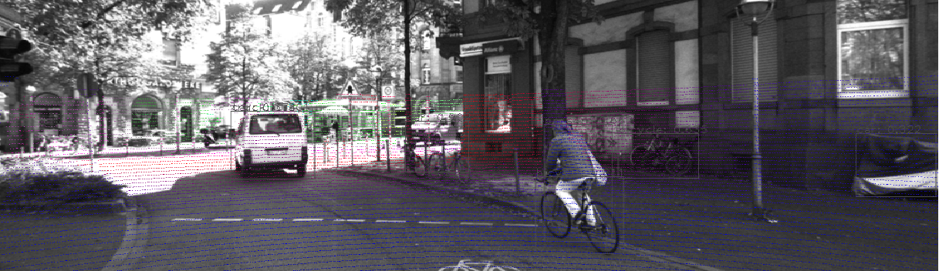
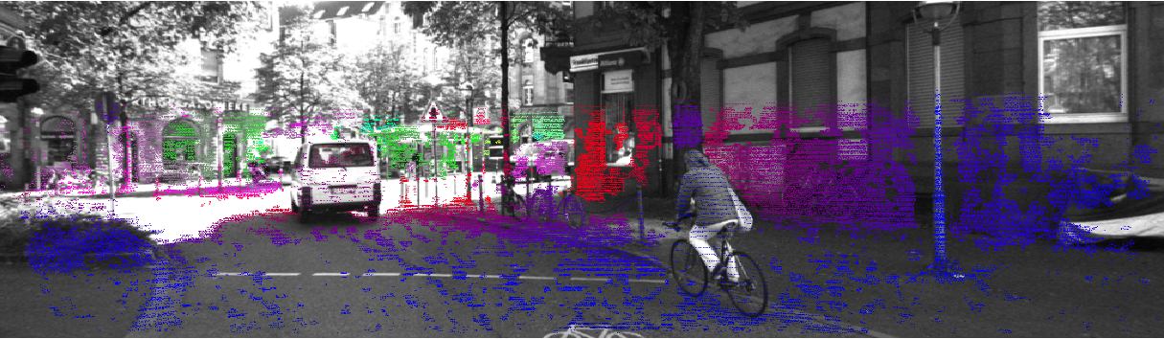
Experiment result 1 (Inside ROI)
Environment Setup
KITTI dataset is used for experiments
The raw depth as input and ground truth for evaluation
Inside ROI, raw depth has a sampling rate of 7-8%
Budget inside ROI is fixed with 1000 samples/scan
Approximately 1% sampling rate
Methods in evaluation
(1) Random sampling
(2) Two-step sampling
(3) Proposed algorithm
Raw scan
Ground truth
An example of KITTI raw and ground truth depth image

Slide 12
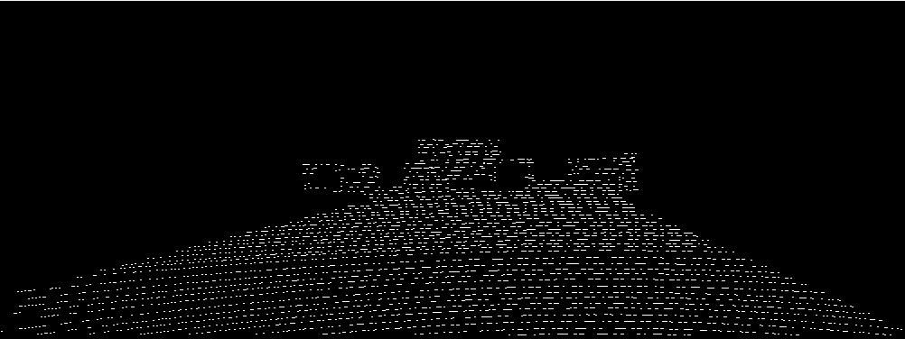
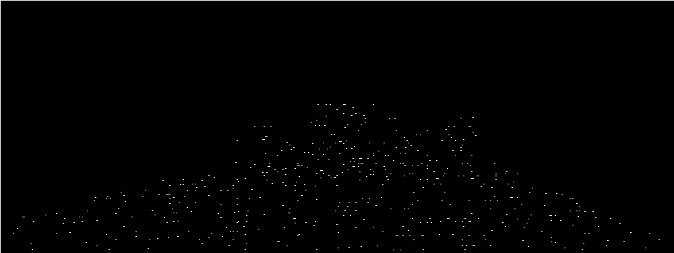
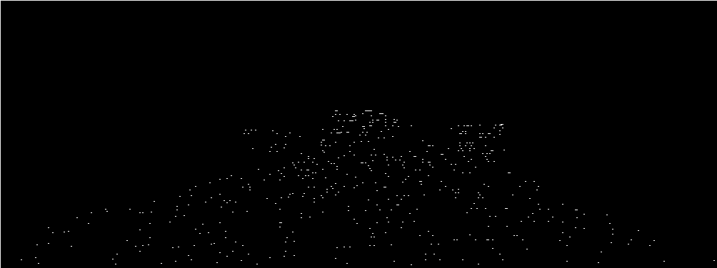
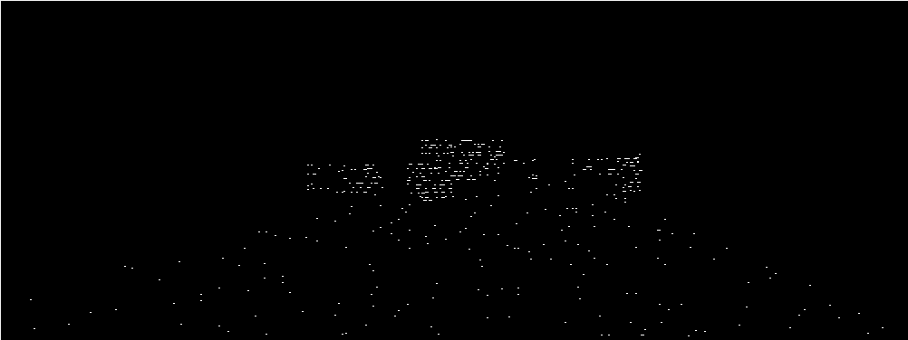
Experiment result 1 (Inside ROI)
Objective evaluation
Sampling mask
The proposed sampling algorithm has much denser mask in the objects area
(a) Full mask of raw depth
(b) Random sampling
(c) two-step sampling
(d) Proposed algorithm
Full set of available samples on raw depth (a) and sampling mask of random sampling (b), two-step sampling (c) and proposed algorithm (d)

Slide 13
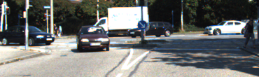





Experiment result 1 (Inside ROI)
Objective evaluation
Reconstruction result
The proposed algorithm has denser sampling rate in objects’ area
Consequently, it produces better reconstruction result
(a) Ground truth
(b) From raw depth (upper-bound performance)
(c) Random sampling
(d) two-step sampling
(e) Proposed algorithm
Zoomed out of objects’ area in depth ground truth (a) and the reconstruction result from raw depth (b), random sampling (c), two-step sampling (d) and proposed algorithm (e)

Slide 14
Experiment result 1 (Inside ROI)
Quantitative evaluation
The sampling budget is N = 1000 samples/scan
Comments
With the same sampling budget, the proposed algorithm gives the best result in objects area
Objects area is the main Region of Interest
With little scarifying on road area (2cm in MAE), the proposed method yields the best result in ROI area
N | Method | MAE (m)
 |  | Object | Road | ROI
1000 | Random | 3.453 | 0.1699 | 0.3037
 | Two-step | 2.946 | 0.1653 | 0.2799
 | Proposed | 2.207 | 0.1848 | 0.2635

Slide 15
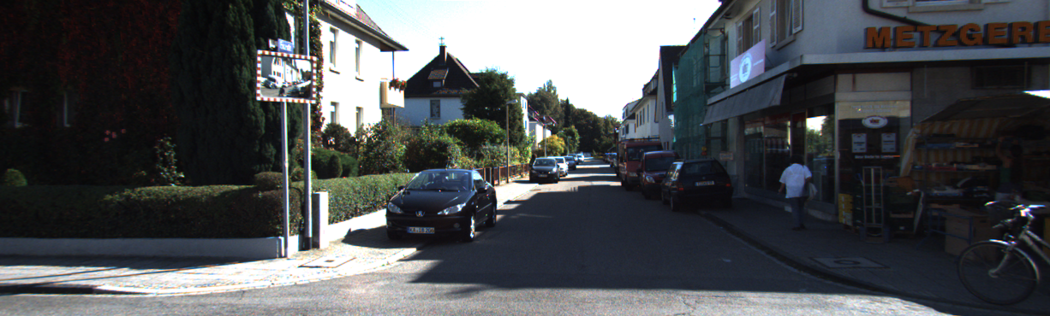
Experiment result 2 (entire FOV)
Environment setup
Budget for entire Field Of View is fixed with 2000 samples/scan
Approximately 1% sampling rate
Sampling mask comparison
Image of the scene

Slide 16
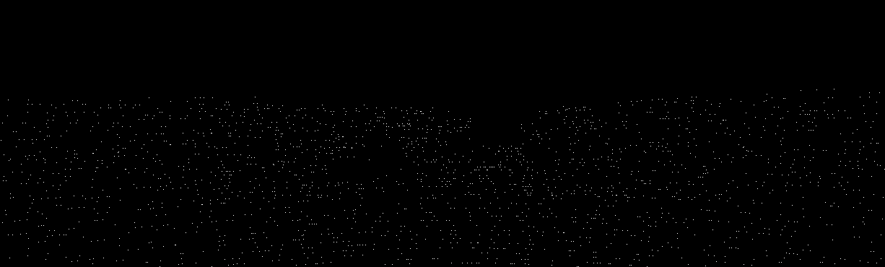
Experiment result 2 (entire FOV)
Environment setup
Budget for entire Field Of View is fixed with 2000 samples/scan
Approximately 1% sampling rate
Sampling mask comparison
Sampling mask of random sampling

Slide 17
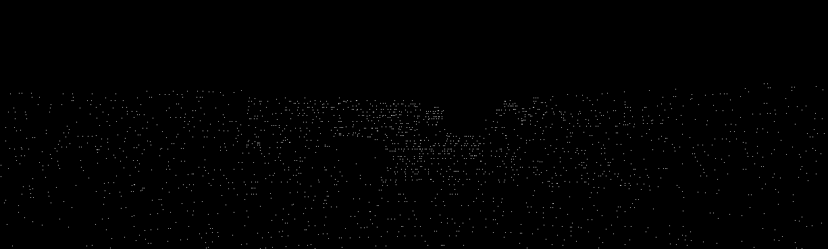
Experiment result 2 (entire FOV)
Environment setup
Budget for entire Field Of View is fixed with 2000 samples/scan
Approximately 1% sampling rate
Sampling mask comparison
Sampling mask of two-step sampling

Slide 18
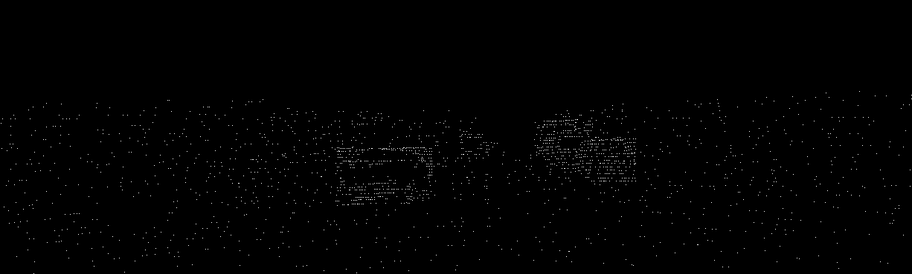
Experiment result 2 (entire FOV)
Environment setup
Budget for entire Field Of View is fixed with 2000 samples/scan
Approximately 1% sampling rate
Sampling mask comparison
The proposed algorithm has more samples in objects area
Sampling mask of proposed algorithm

Slide 19
Experiment result 2 (entire FOV)
Quantitative results
Comments
Proposed algorithm concentrates samples to objects area with little sacrifice of localization result
The reconstruction results of ROI area, especially the objects area are significantly improved
MAE of objects area with the proposed approach reduces 49.1% compared to that with random sampling
Budget | Method | MAE (m) |  |  |  | Localization - translation drift(m)
 |  | objects | road | ROI | background
2000 | Random | 2.2953 | 0.143 | 0.3771 | 0.9699 | 0.12461
 | Two-step | 2.1221 | 0.141 | 0.3819 | 0.9128 | 0.09205
 | Proposed | 1.1684 | 0.197 | 0.3241 | 1.048 | 0.12103

Slide 20
Conclusion
This paper proposes an algorithm to distribute LiDAR sampling budget in the road environment
A portion of the budget for non-ROI area is moved to ROI area with the consideration of preserving the localization results
A portion of the budget for road area is moved to objects area, which simultaneously increases reconstruction result of entire ROI
Final MAE of objects area reduces 49.1% compared to random sampling and 44.9% compared to two-step sampling
Future work
Synchronization between image and sampling process is an open issue to be solved in the future

Slide 21
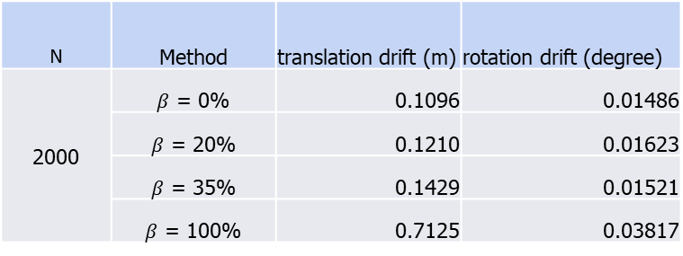
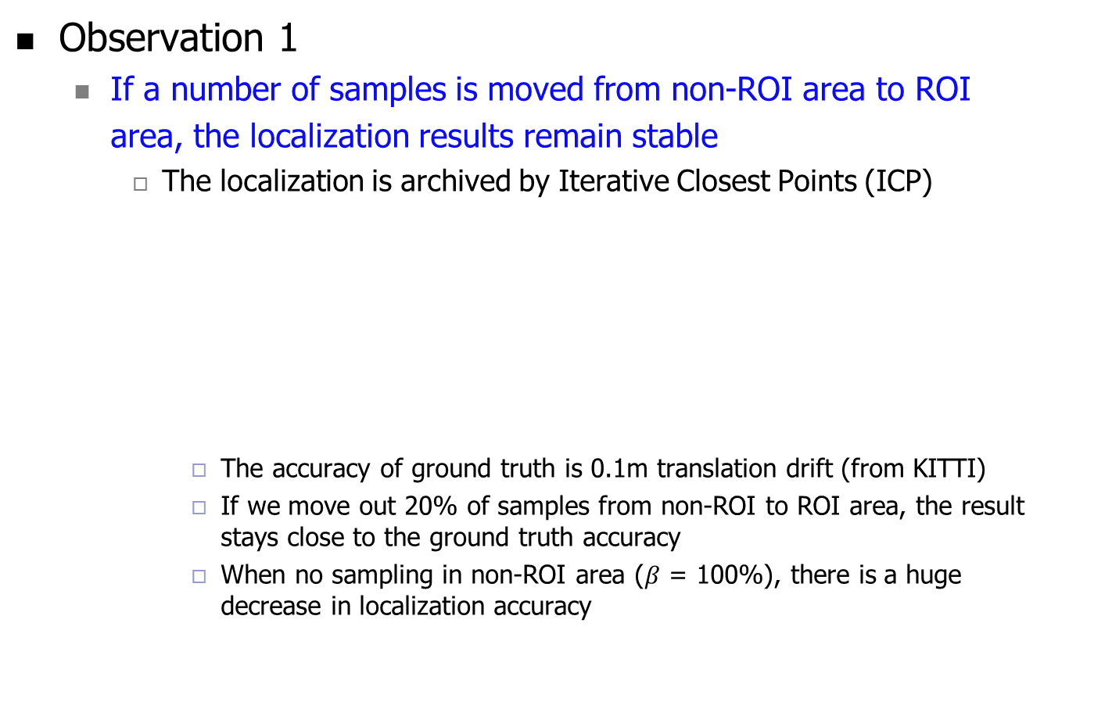
Appendix
Observation 1
If a number of samples is moved from non-ROI area to ROI area, the localization results remain stable
The localization is archived by Iterative Closest Points (ICP)
The accuracy of ground truth is 0.1m translation drift (from KITTI)
If we move out 20% of samples from non-ROI to ROI area, the result stays close to the ground truth accuracy
When no sampling in non-ROI area ($β$ = 100%), there is a huge decrease in localization accuracy
N | Method | translation drift (m) | rotation drift (degree)
2000 | $β$ = 0% | 0.1096 | 0.01486
 | $β$ = 20% | 0.1210 | 0.01623
 | $β$ = 35% | 0.1429 | 0.01521
 | $β$ = 100% | 0.7125 | 0.03817
ICP results after moving out $β$ percent of samples out of non-ROI area

